Slide 1

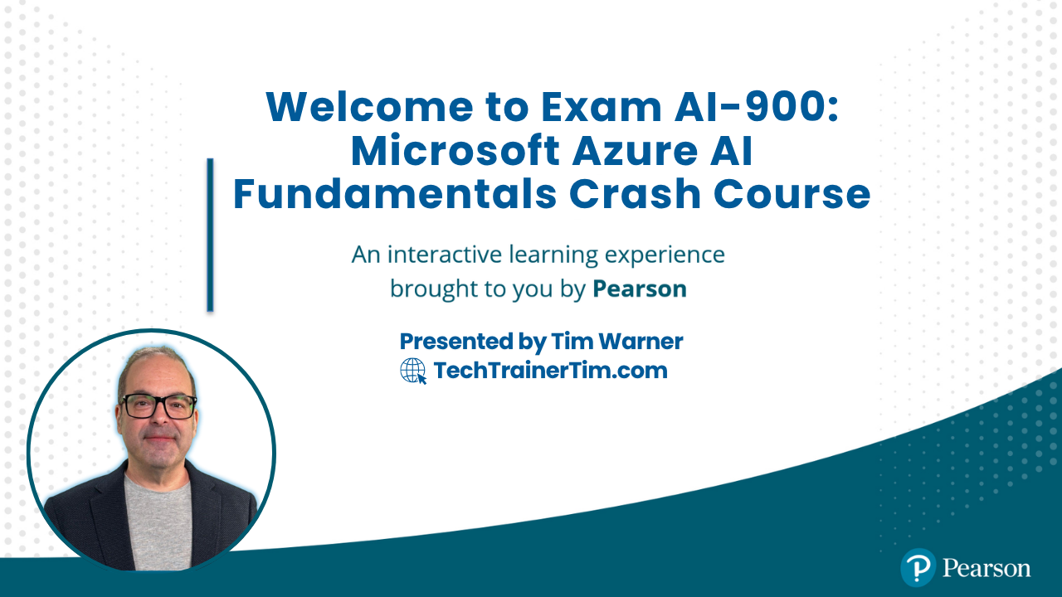
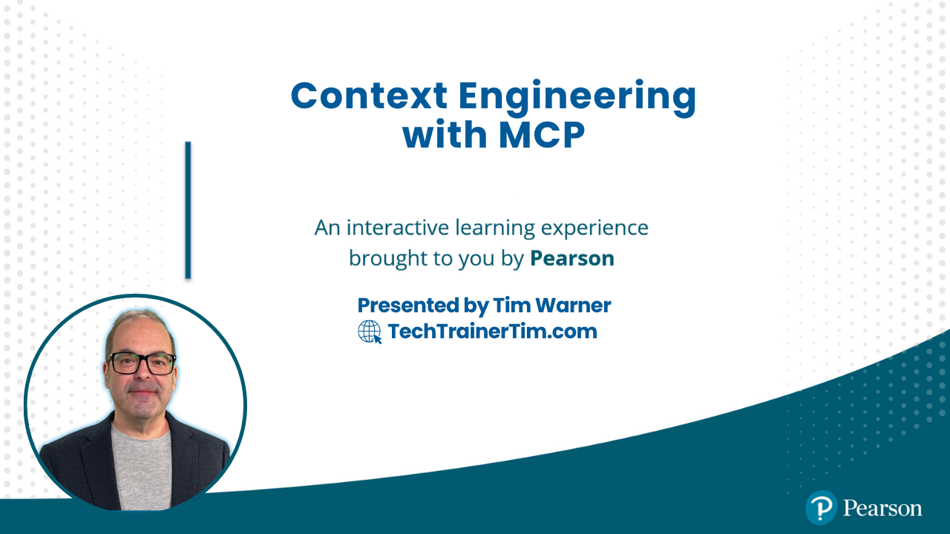
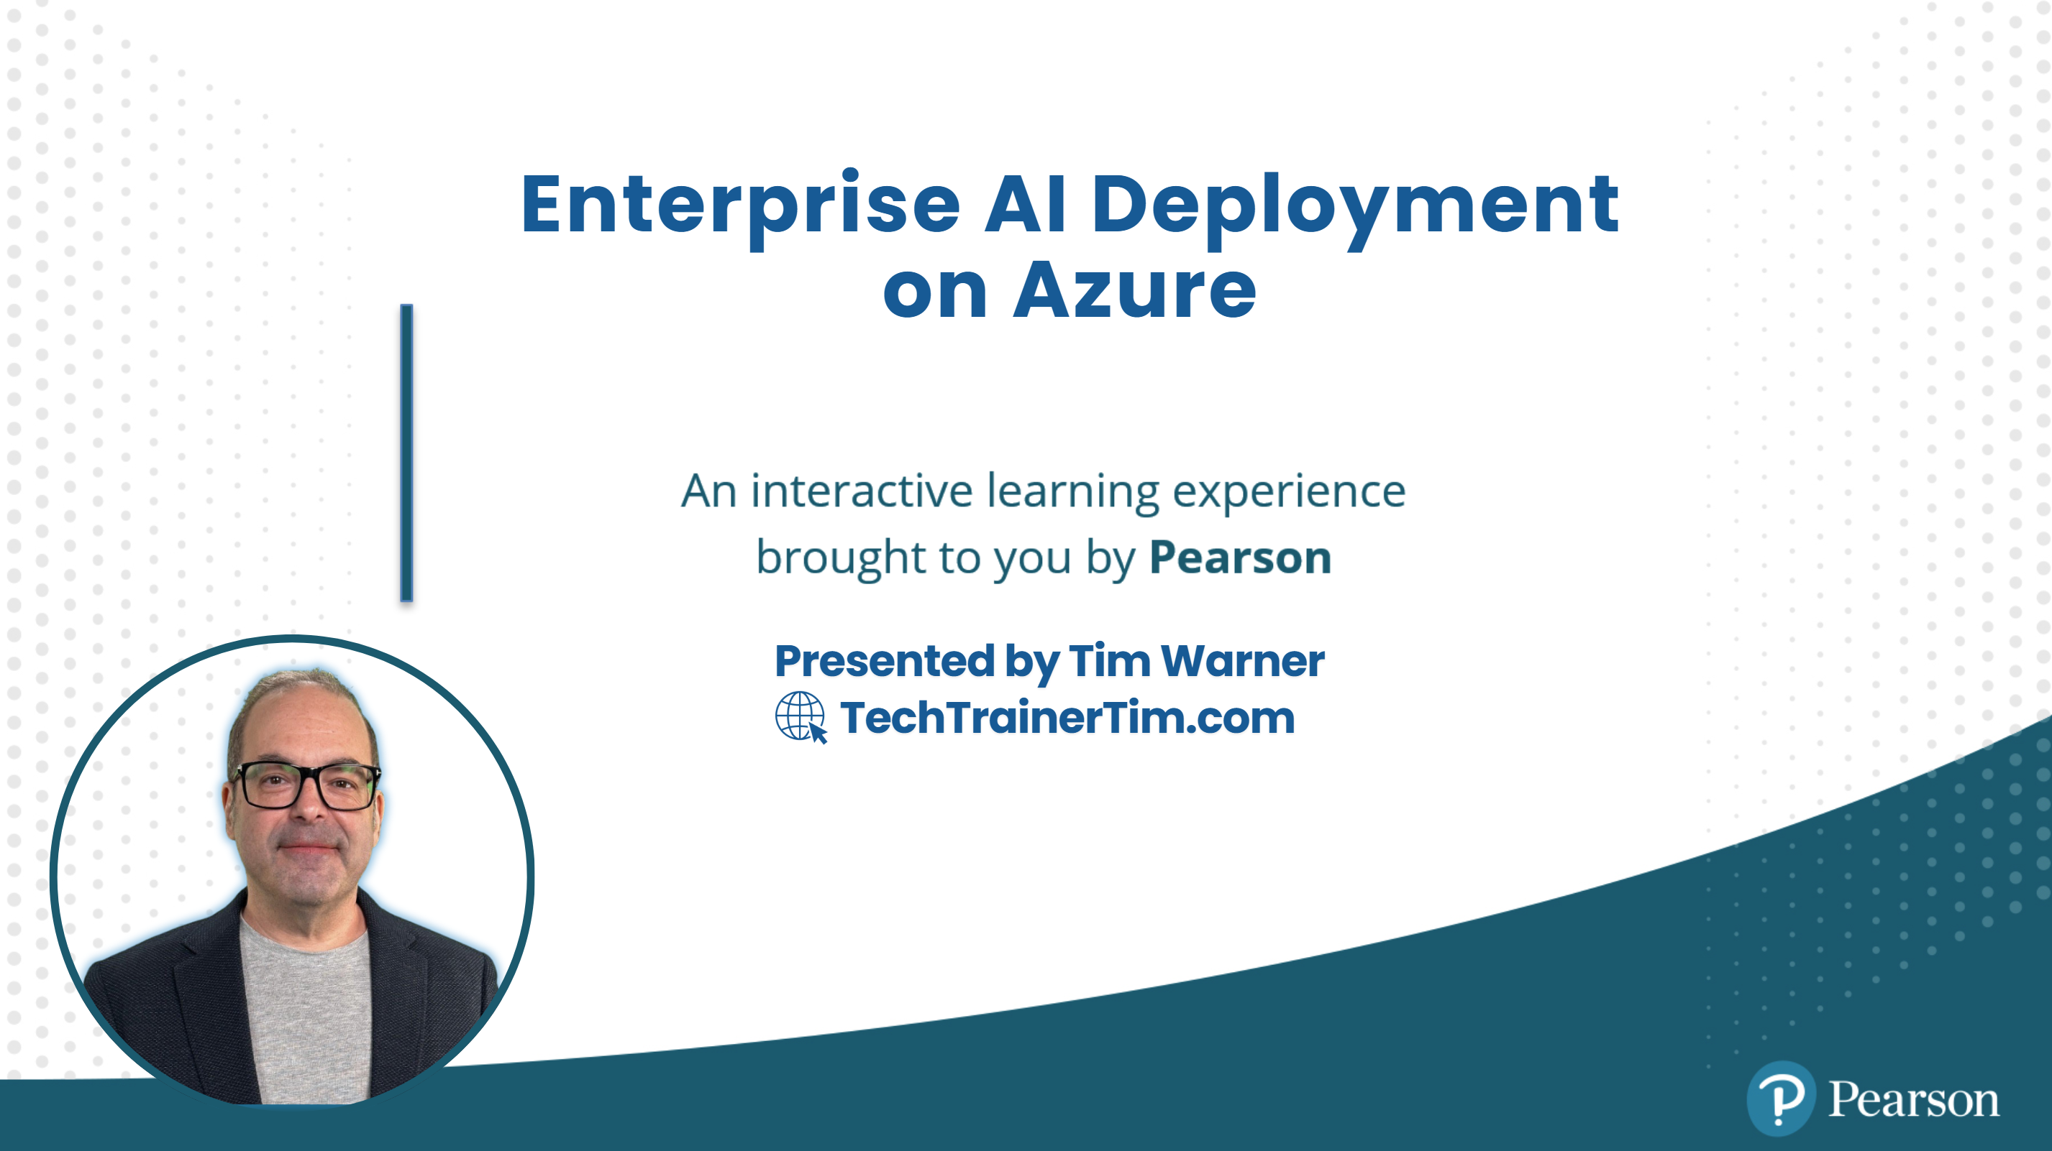

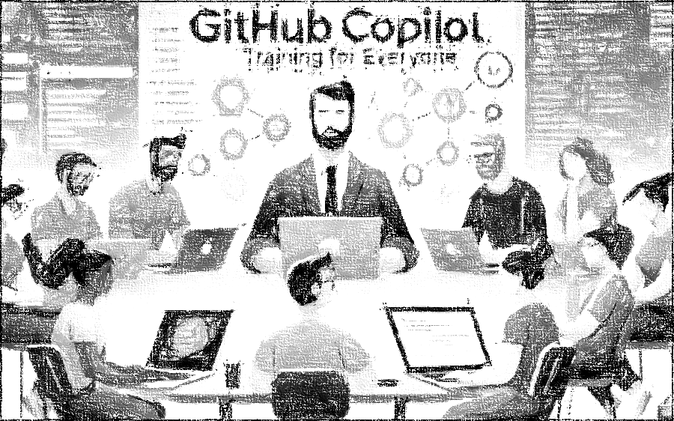


GitHub Copilot for Almost Everyone
Tim Warner
timw.info/linkedin
Notes:
How much flexibility am I allowed with these slide layouts? If you right-click a slide, you can play with layouts, but otherwise, not much flexibility.
Am I free to add my own graphics, providing MSFT attribution where necessary? When it comes to MS graphics, we're not allowed to use those, so please do not add in graphics unless they are created FROM SCRATCH by you.
Can I make the font a bit smaller? Some of the objectives are verbose and I don’t want to crowd the skills? Yes, I do this, too, when I review the slides because sometimes the default size just won't work.
Do the bullet points here need to be word-for-word from the outline or can I condense? We prefer word-for-word, but some of the sub-lesson titles are super long. Use your discretion, and we can address case-by-case during the review of each lesson's slides.

Slide 2

Tim Warner
Based in Nashville, TN, US
Microsoft tech specialist and trainer since 1997 (Windows NT 4.0)
Microsoft Certified Trainer (MCT)
Microsoft MVP in Azure AI & Cloud/Datacenter Management
Contact: TechTrainerTim.com

Slide 3
Course Flow (Central Time Zone)
11:00 am - Segment 1 [Understanding Context]
12:00 pm - 10-min break - Segment 2 [Build Local MCP]
01:00 pm - 10-min break - Segment 3 [Build Remote MCP]
02:00 pm - 10-min break - Segment 4 [Future Trends]
03:00 pm - Finish

Slide 4
Course materials
timw.info/context

Slide 5
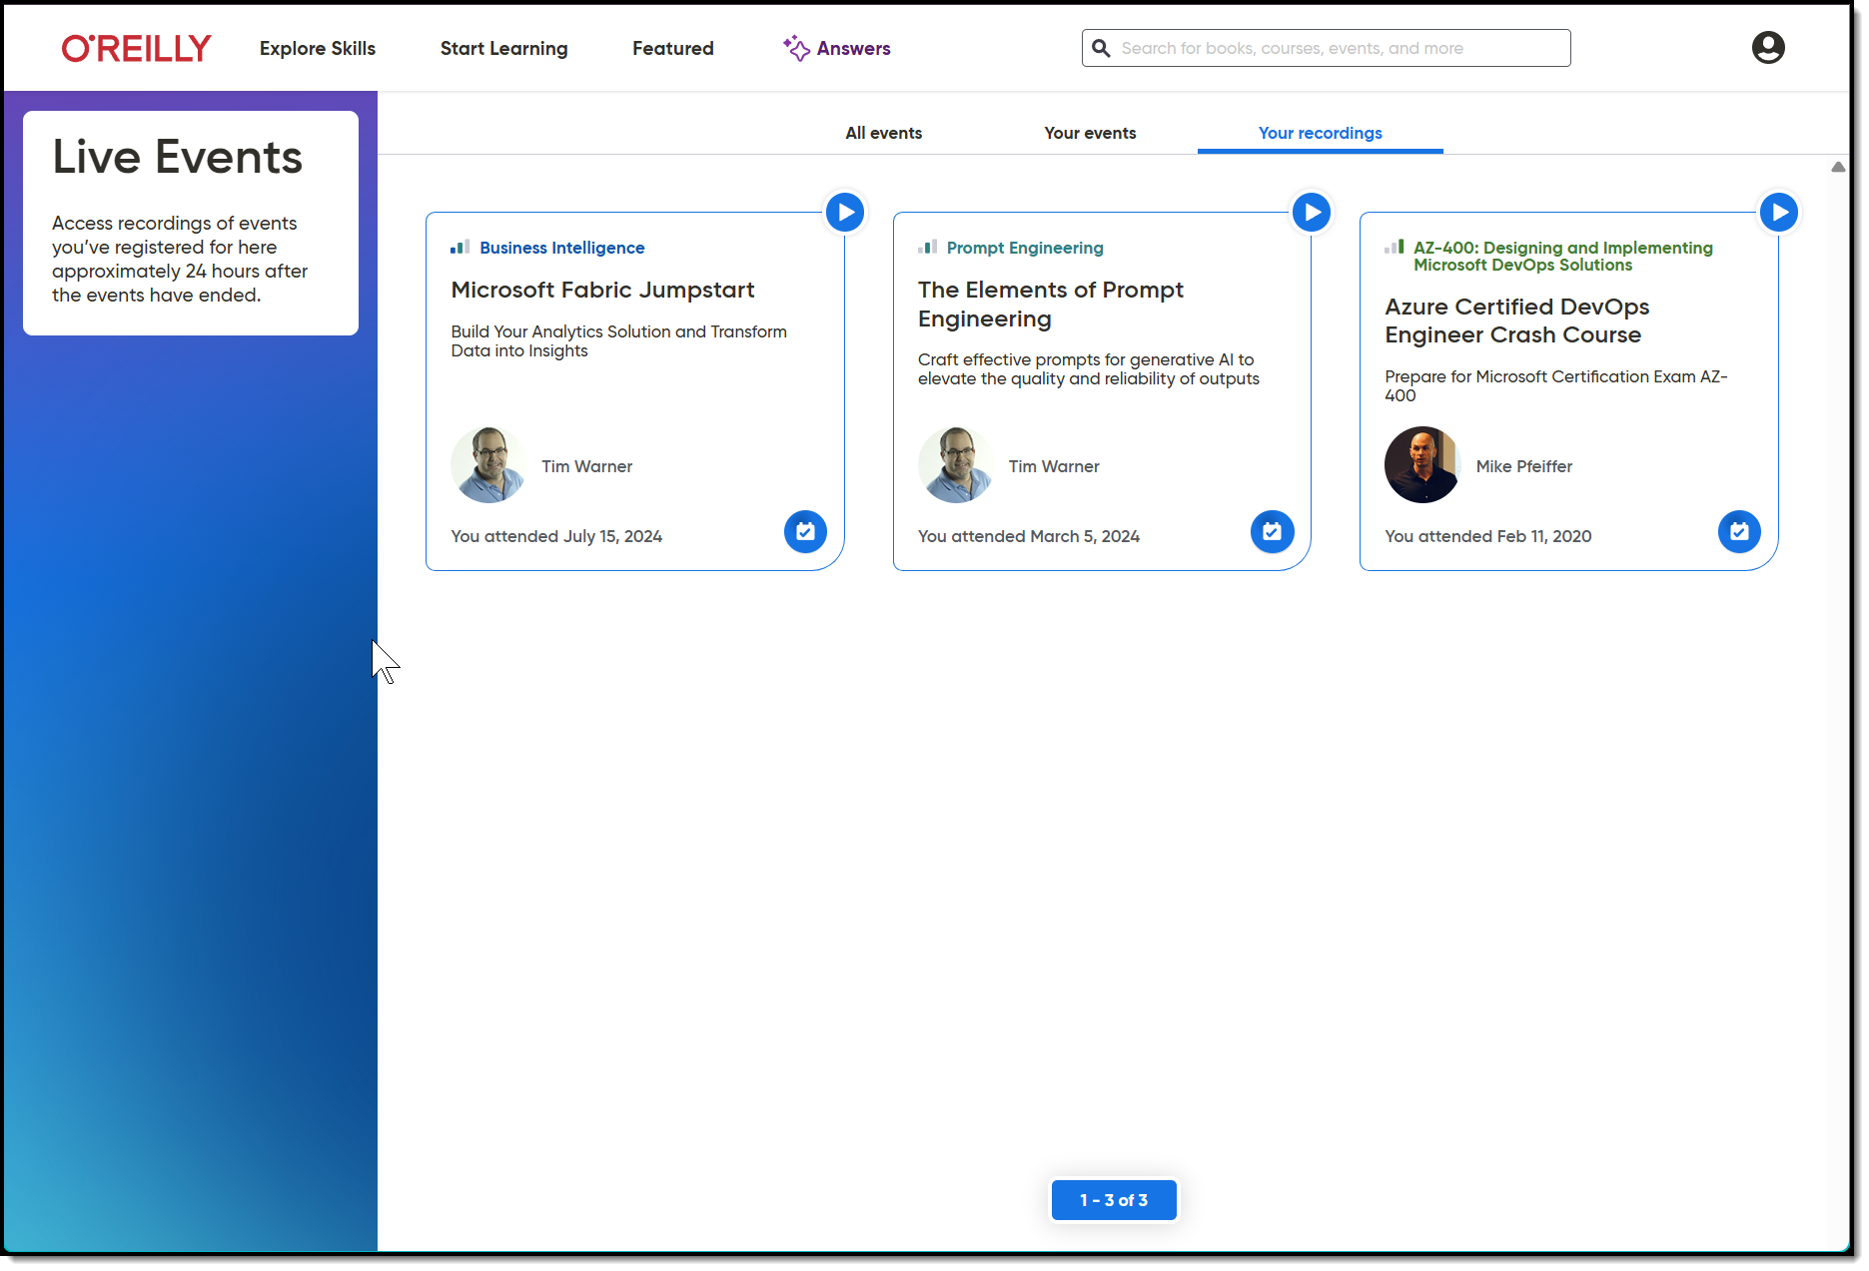
Session Recording + Badge

Slide 6
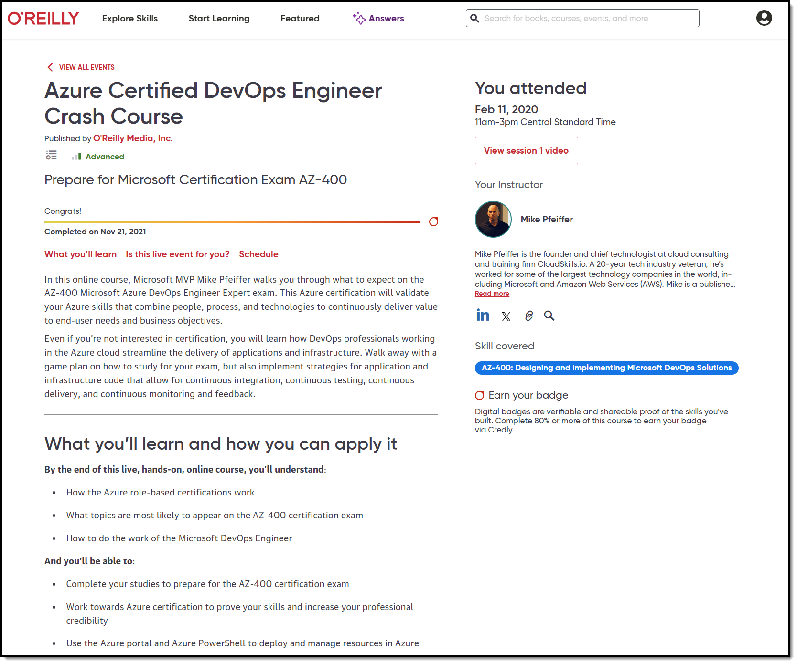
Session Recording + Badge

Slide 7
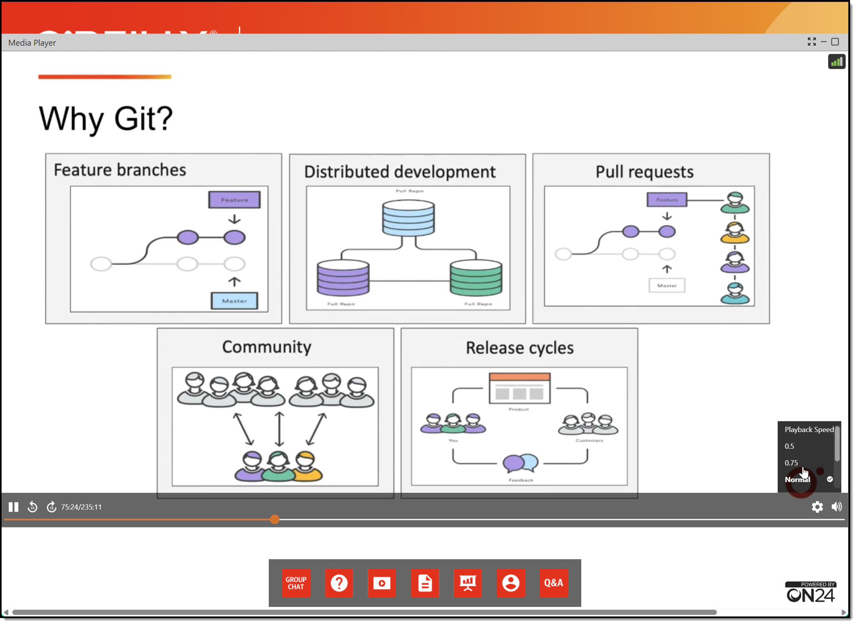
Session Recording + Badge

Slide 8
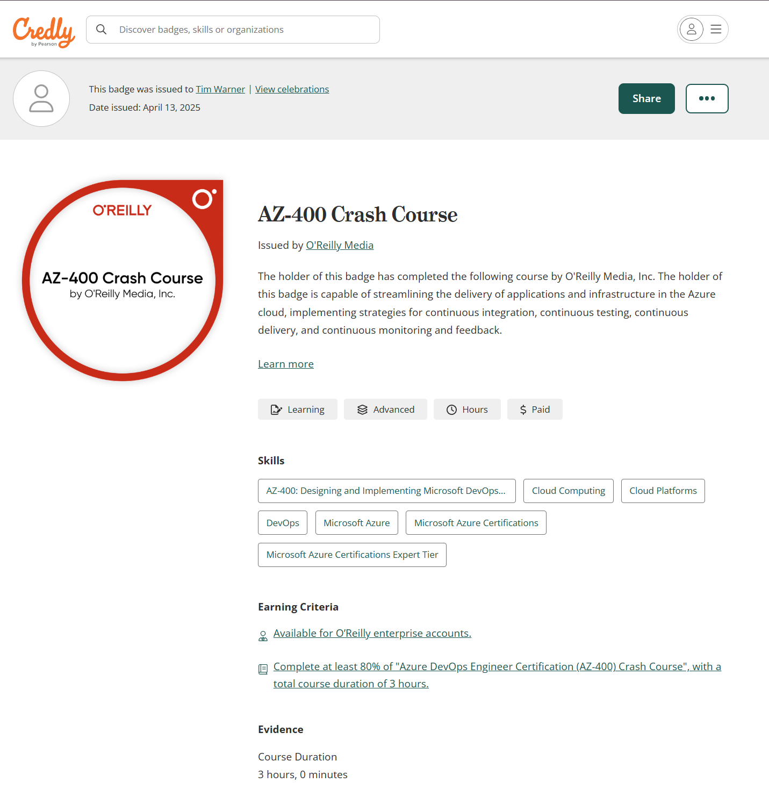
Session Recording + Badge

Slide 9
🔤 How AI Reads Your Prompts
Understanding Tokenization for Better MCP Context
O'Reilly Learning Platform

Slide 10
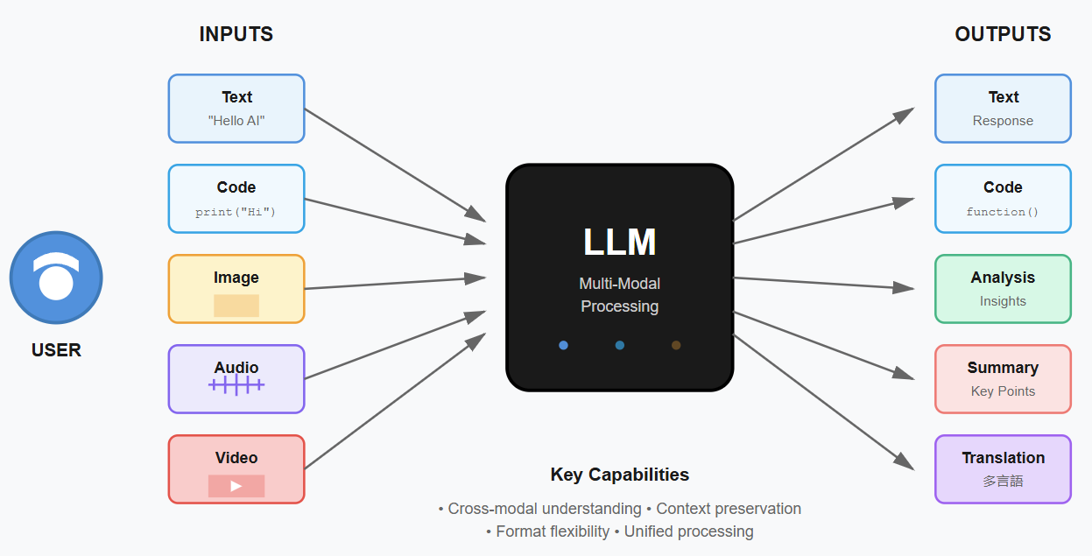
LLM Multi-Modal Processing
Notes:
Image credit: Tim + Claude AI

Slide 11
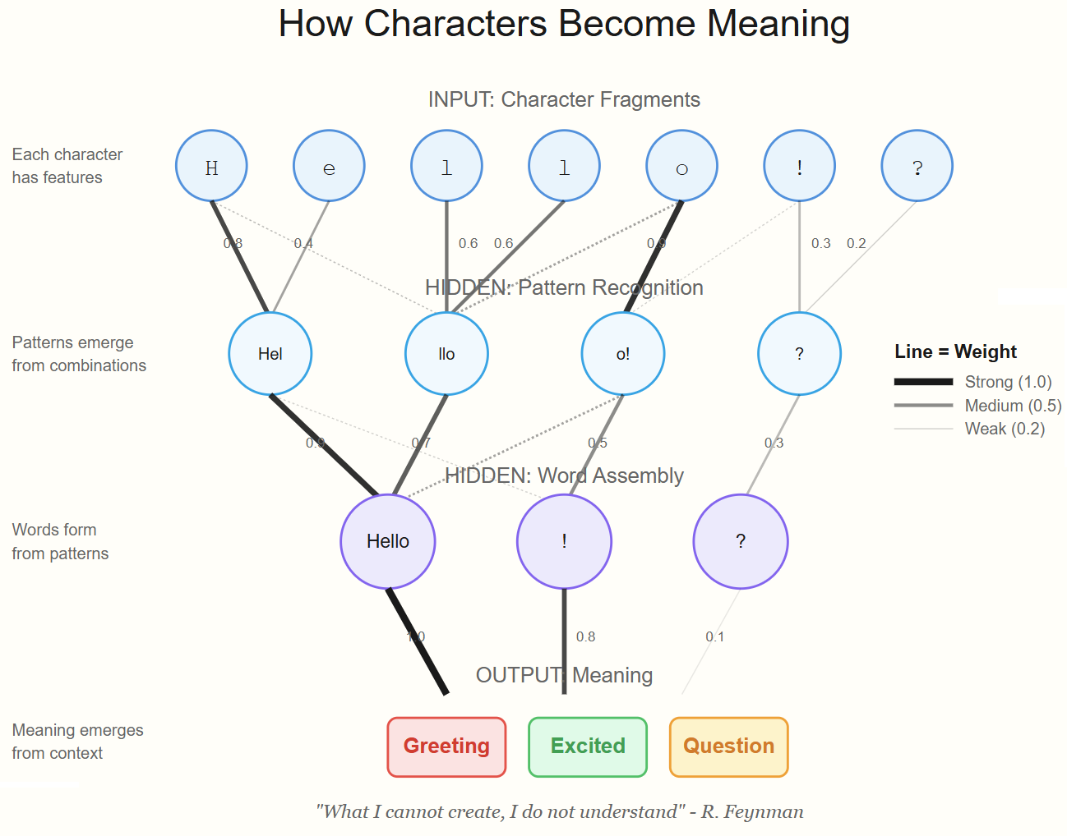
Neural Network
Notes:
Image credit: Tim + Claude AI

Slide 12
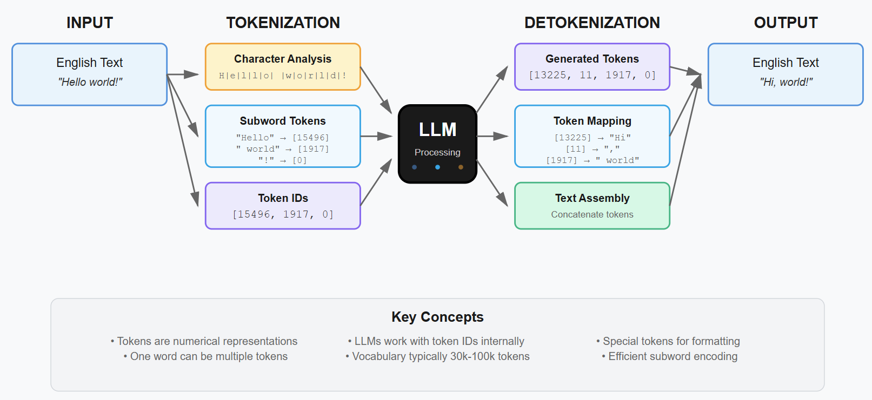
Tokenization Process in LLMs

Slide 13

Context Length

Slide 14
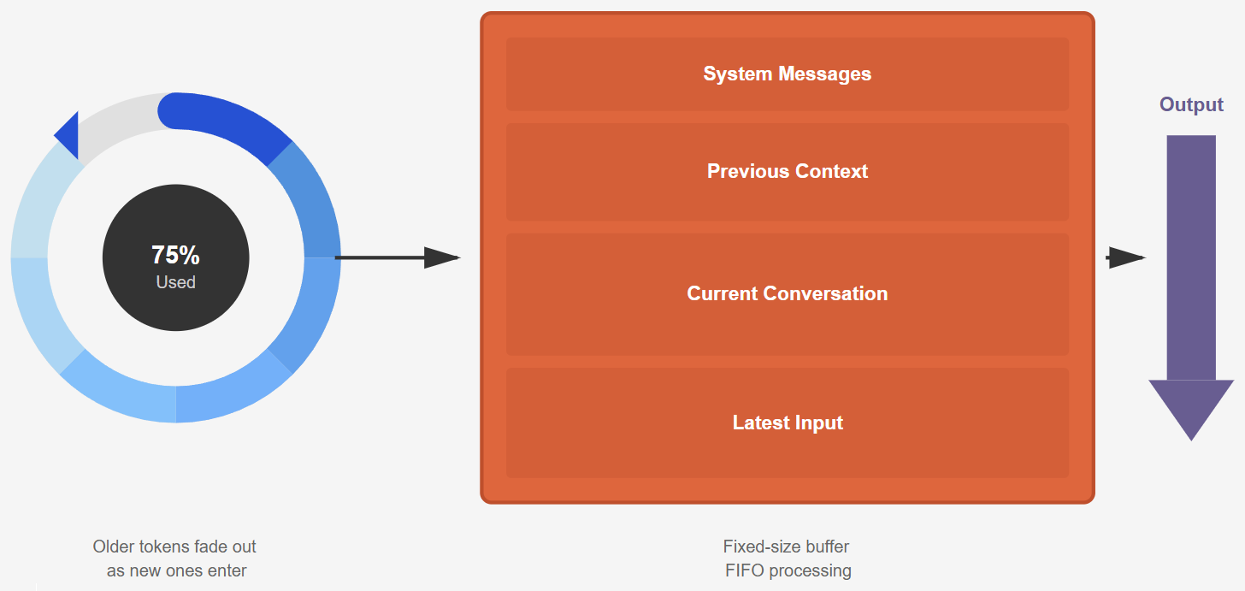
Context Window
Notes:
Illustration credit: Tim

Slide 15
Step 1: Breaking Text into Chunks (Tokens)
What You Type
AI Breaks It Down
What AI Sees
"Context engineering improves AI"
Splits into meaningful pieces
(like puzzle pieces)
["Context", " engineering",
" improves", " AI"]
→
→

Slide 16
Step 2: AI Reads in Both Directions Simultaneously
"Context"
" engineering"
" improves"
" AI"
[END]
Chunk #1
Chunk #2
Chunk #3
Chunk #4
Done
← Looks Backward
Looks Forward →
Each chunk connects to every other chunk at once,
so AI understands the full meaning from all directions

Slide 17
Why This Matters for Your MCP Work
💰
🔄
📏
Cost & Speed
Full Context Reading
Memory Limit
More tokens = higher cost and slower responses. Keep prompts concise.
Modern AI sees your entire message at once for better understanding.
Claude holds ~200K chunks. Strategic placement matters for quality.
🎯
🧩
📍
Position Matters
Word Breaking
Structure Prompts
Put critical info at beginning or end—AI pays more attention there.
Unknown words split into pieces. "TechTrainerTim" → ["Tech", "Trainer", "Tim"]
Use clear sections, headers, bullets to help AI find information faster.

Slide 18
Practical Tips for Better AI Prompts
• Put important stuff first: AI pays closest attention to the beginning
• Use clear section breaks: Headers, bullets, and whitespace help AI organize
• Watch your word count: Longer isn't always better—be concise and specific
• Repeat key terms: If something matters, mention it multiple times
• Test and iterate: Try different phrasings to see what gets better results

Slide 19
🔗 Model Context Protocol (MCP)
Connecting AI to Your World
O'Reilly Learning Platform

Slide 20
How MCP Works: The Three-Layer Architecture
🤖
⚙️
💾
AI Host
MCP Server
Your Resources
Your AI application that needs
access to data and tools
→
Translator that speaks both
AI and your tools' languages
→
Databases, files, APIs you
want AI to access
Claude Desktop, VS Code
Handles requests
Notion, GitHub, Filesystem

Slide 21
📨 The Communication Flow
1
2
3
4
Request
Translate
Fetch
Deliver
→
→
→
AI asks: "Show me my
Notion docs about MCP"
MCP Server converts
to Notion API format
Server retrieves data
from Notion workspace
AI receives clean,
structured data

Slide 22
🎯 Why MCP Changes Everything
🔌
🔒
⚡
Universal Standard
Security First
Real-Time Access
One protocol works with any AI
and any data source
Your data stays on your systems.
AI only sees what you permit
AI works with live data,
not outdated snapshots
🧩
📈
🛠️
Composable
Scales Easily
Developer Friendly
Mix and match multiple servers
for custom workflows
Add new data sources without
rebuilding infrastructure
Build once, deploy anywhere.
Works across all AI hosts

Slide 23
🚀 Real-World Applications
📝 Knowledge Management
💻 Development Workflow
Connect AI to Notion, Confluence, or SharePoint to search and create docs
Link AI to GitHub to read code, create PRs, and manage issues
"Find all meeting notes from Q4 mentioning Azure costs"
"Review my PR #342 and suggest performance improvements"
📊 Data Analysis
🎬 Content Creation
Connect databases and spreadsheets to query data through natural language
Integrate scripts, outlines, and media libraries for content pipeline
"Show me subscriber growth trends for the past 6 months"
"Create outline for my AZ-801 module 3 based on existing notes"

Slide 24
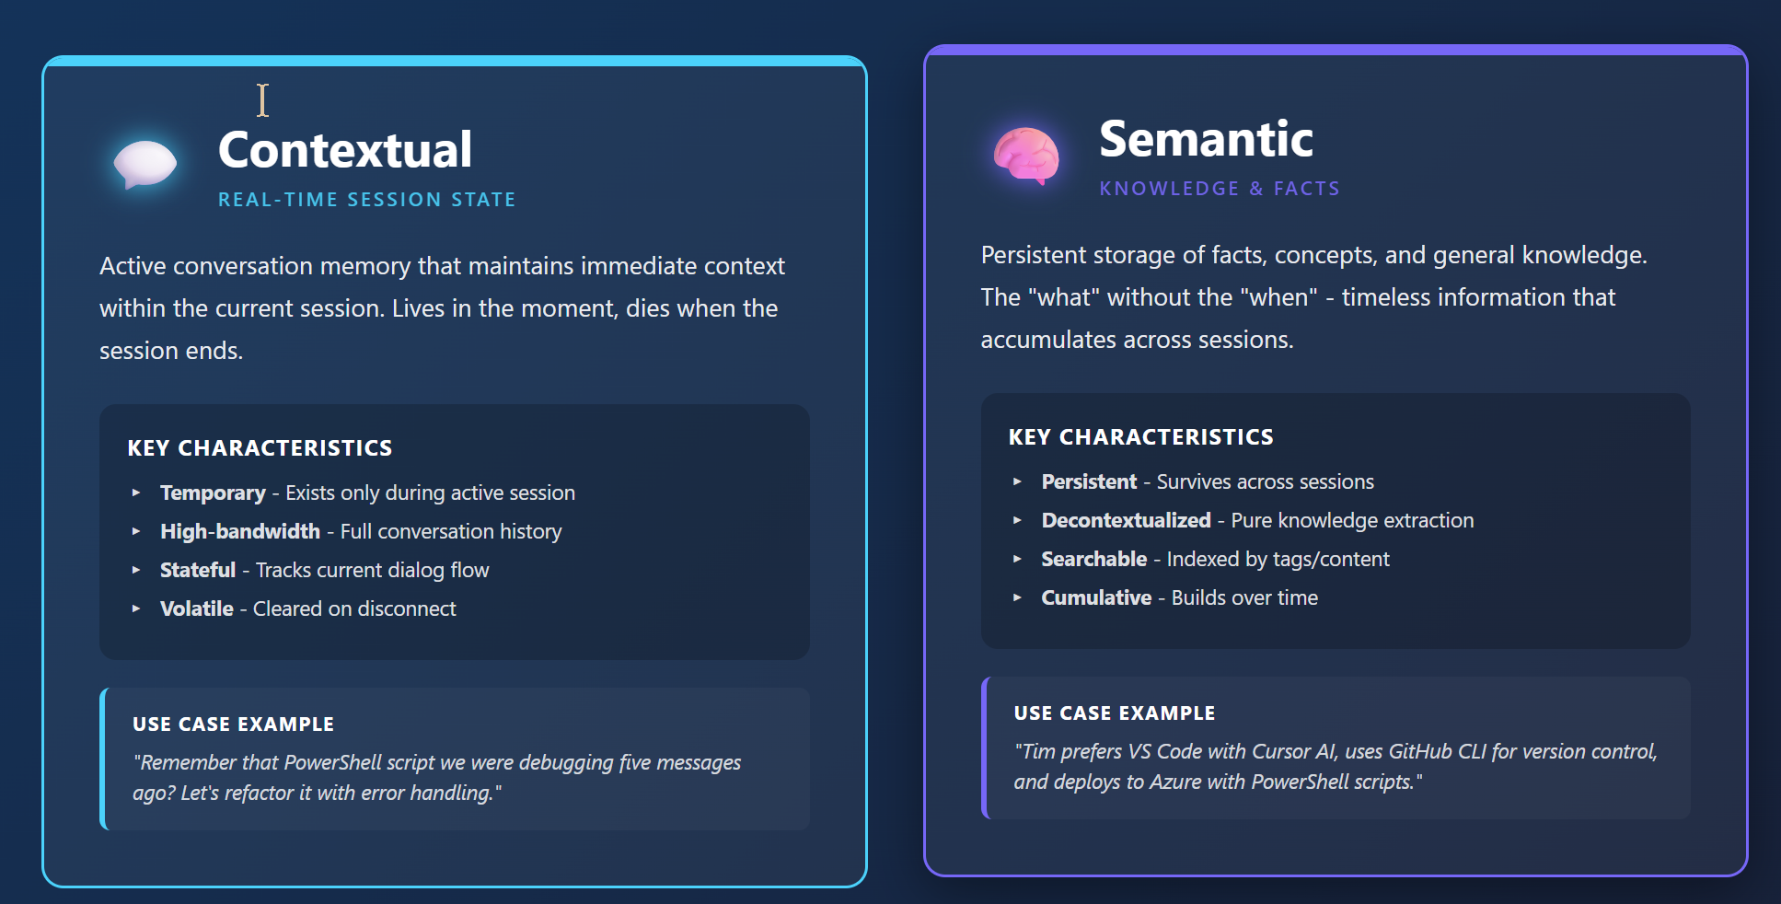
MCP Memory Types

Slide 25
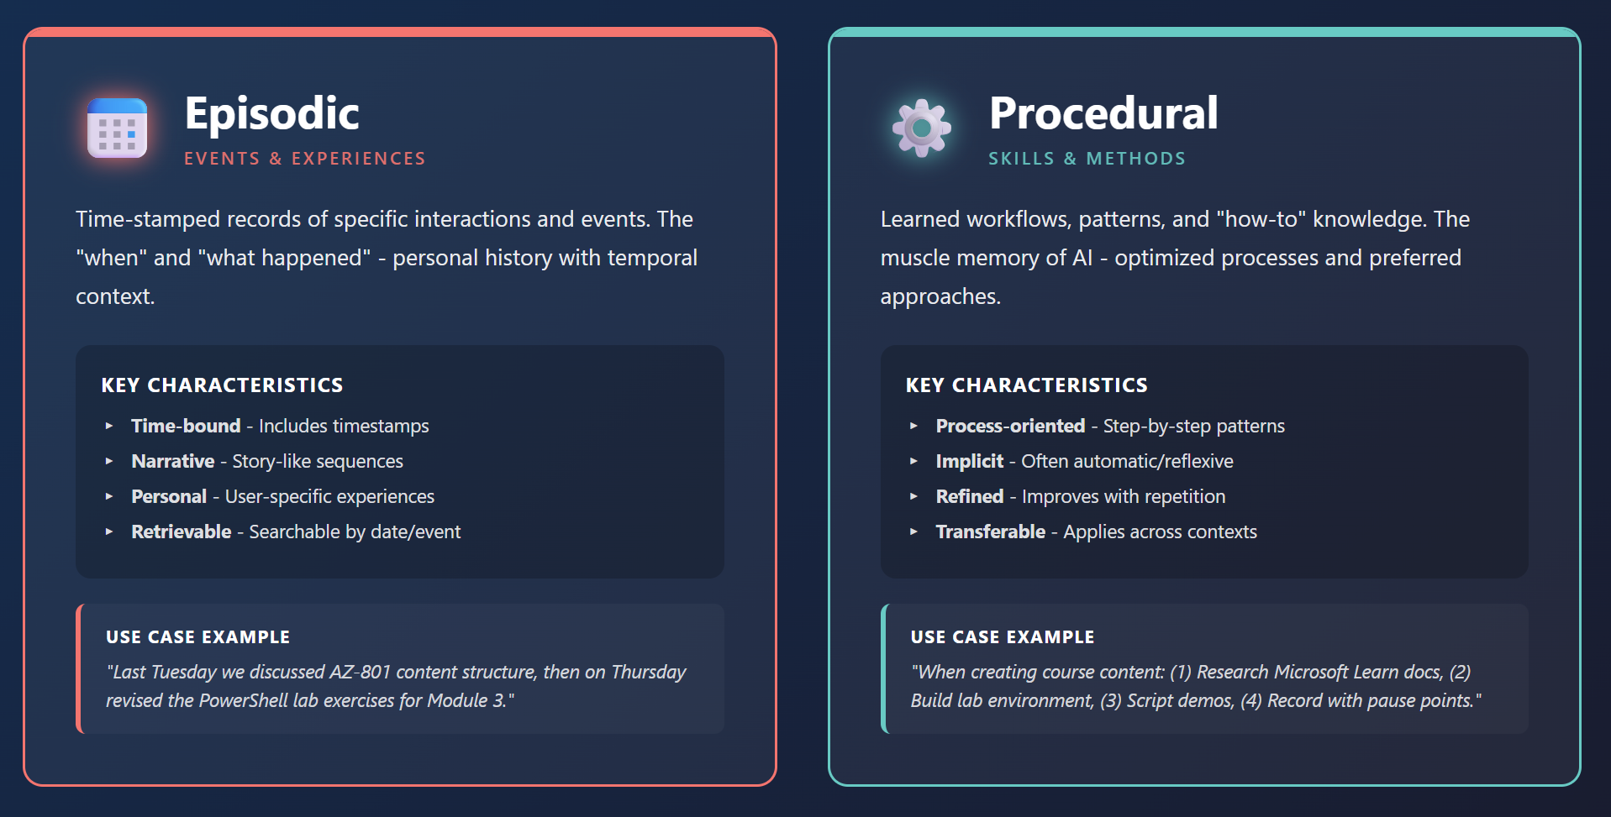
MCP Memory Types

Slide 26
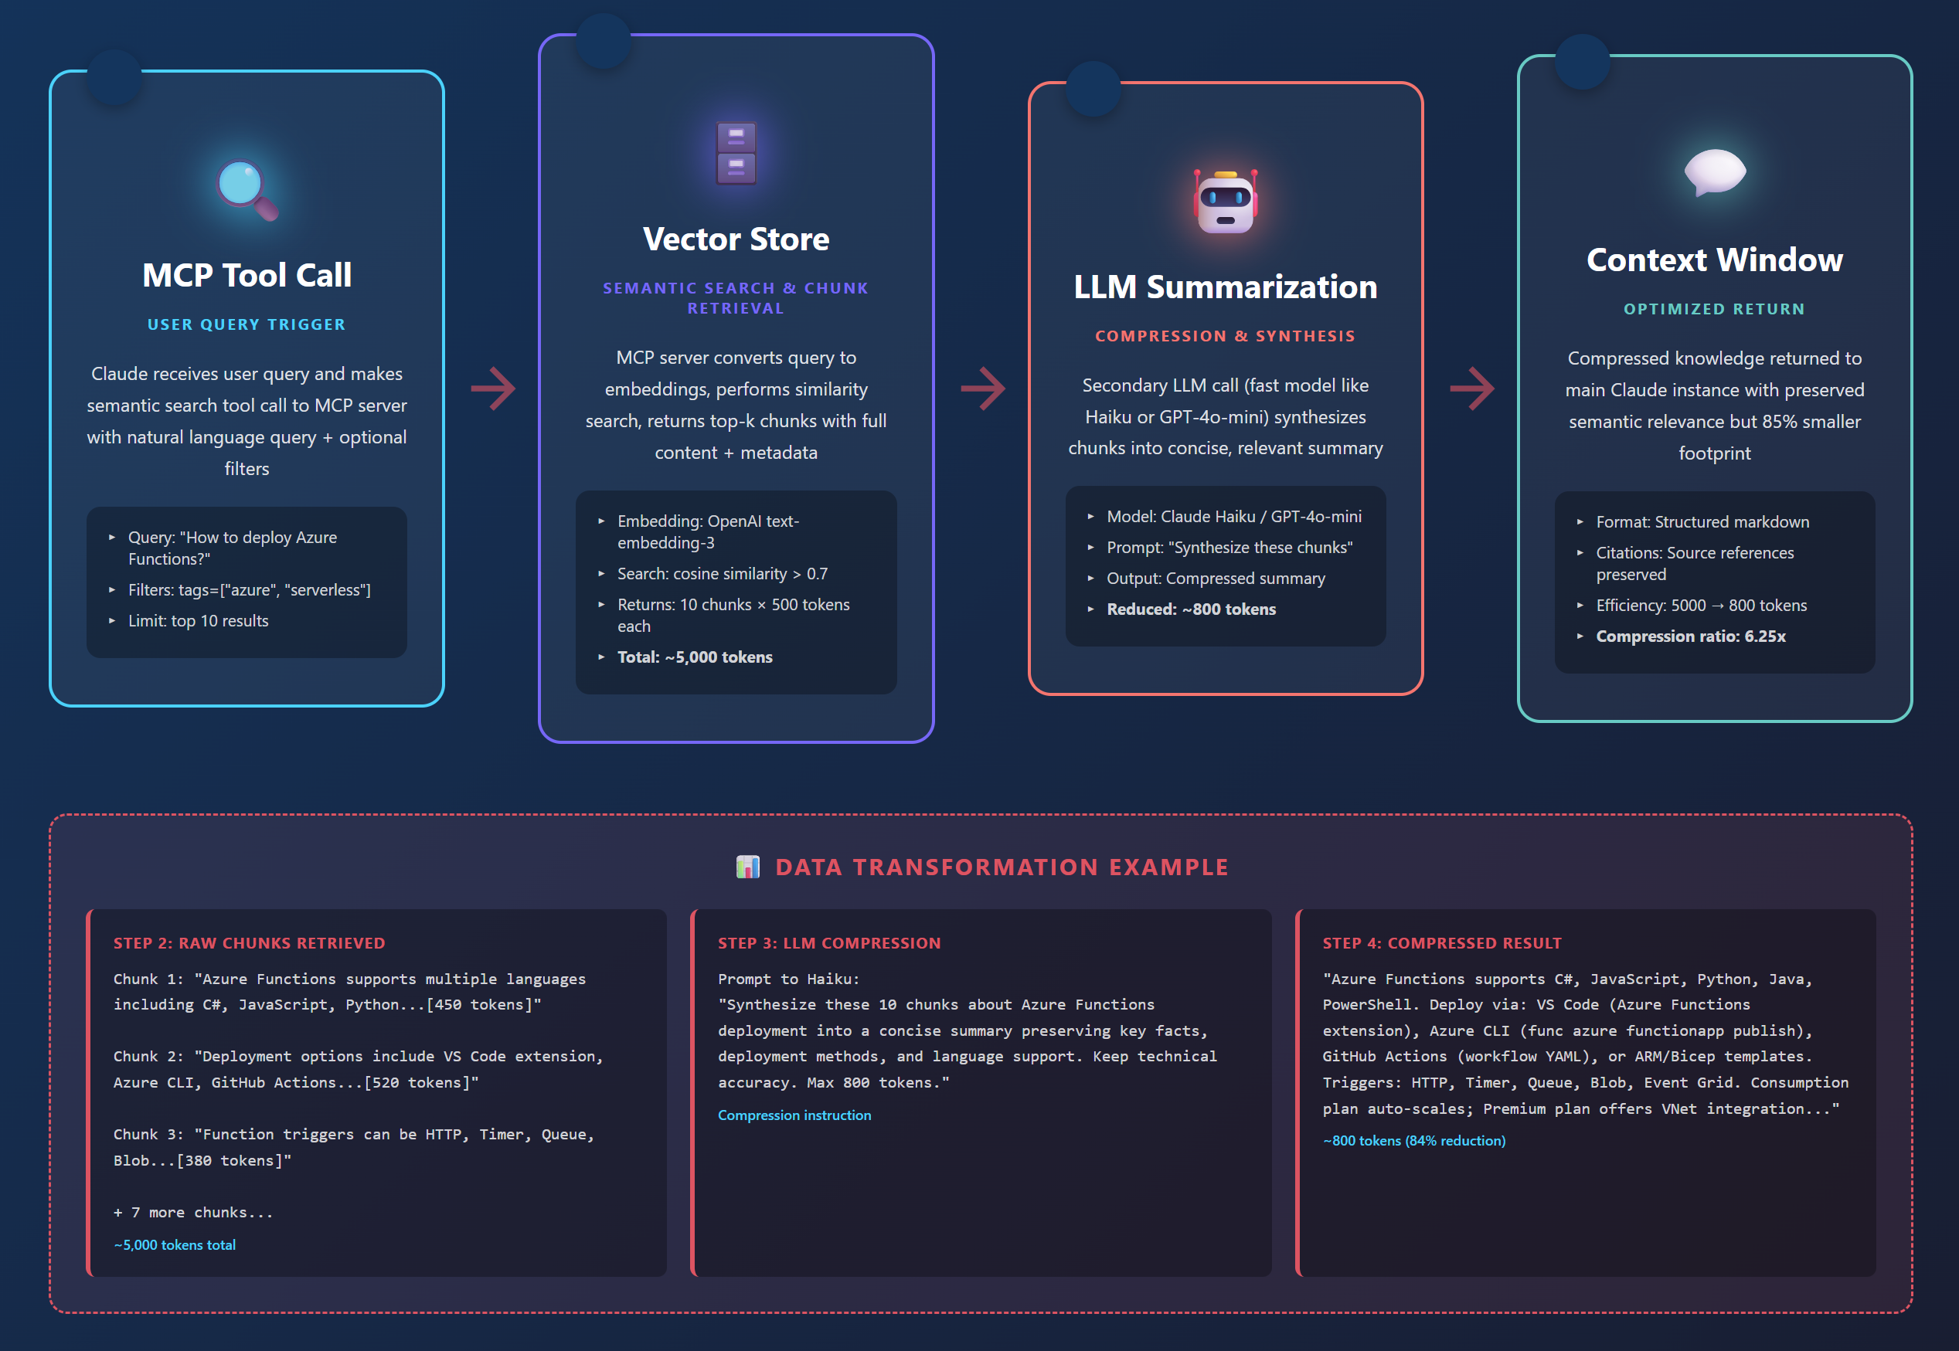
MCP Semantic Compression Pattern

Slide 27
🚀 Building Your First MCP Server
Hello World with Node.js: stdio & HTTP Transport
O'Reilly Learning Platform

Slide 28
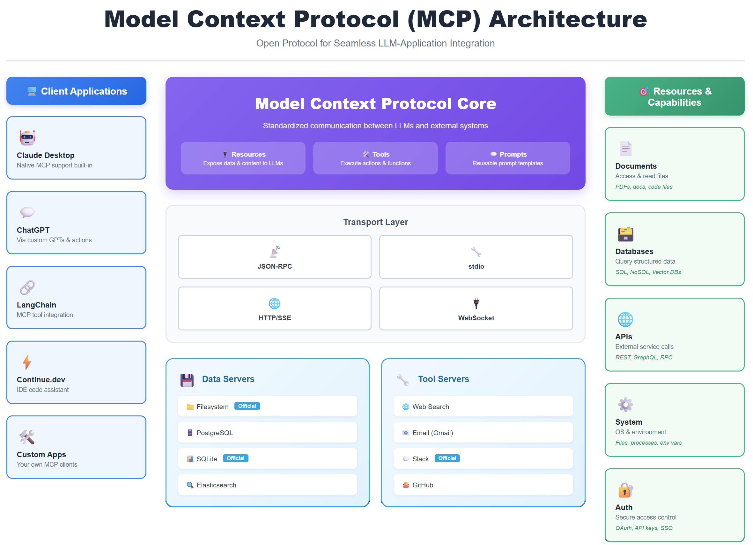

Slide 29
What We're Building Today
A complete 'Hello World' MCP server with two transport methods (stdio + HTTP), one tool (echo), and one resource (greeting message). We'll configure it for local testing with Claude Desktop.
📦
🔧
📄
⚙️
Two Transports
One Tool
One Resource
Full Config
stdio (process)
HTTP (network)
echo command
returns your text
greeting.txt
welcome message
Claude Desktop
setup included

Slide 30
Step 1: Project Setup
1
Create project directory
$ mkdir hello-mcp-server && cd hello-mcp-server
2
Initialize npm project
$ npm init -y
3
Install MCP SDK
$ npm install @modelcontextprotocol/sdk
4
Install dependencies
$ npm install express

Slide 31
Step 2: Server Code - Imports & Server Setup
// server.js
import { Server } from "@modelcontextprotocol/sdk/server/index.js";
import { StdioServerTransport } from "@modelcontextprotocol/sdk/server/stdio.js";
import { SSEServerTransport } from "@modelcontextprotocol/sdk/server/sse.js";
import express from "express";
// Create MCP server instance
const server = new Server(
{
name: "hello-world-mcp",
version: "1.0.0",
},
{
capabilities: {
tools: {}, // Support tools
resources: {}, // Support resources
},
}
);

Slide 32
Step 3: Define the Tool - Echo Command
// Define available tools
server.setRequestHandler("tools/list", async () => {
return {
tools: [
{
name: "echo",
description: "Echoes back the message you send",
inputSchema: {
type: "object",
properties: {
message: {
type: "string",
description: "The message to echo back",
},
},
required: ["message"],
},
},
],
};
});
// Handle tool execution
server.setRequestHandler("tools/call", async (request) => {
if (request.params.name === "echo") {
const message = request.params.arguments.message;
return {
content: [
{
type: "text",
text: `Echo: ${message}`,
},
],
};
}
throw new Error(`Unknown tool: ${request.params.name}`);
});

Slide 33
Step 4: Define the Resource - Greeting Message
// Define available resources
server.setRequestHandler("resources/list", async () => {
return {
resources: [
{
uri: "greeting://hello",
name: "Hello World Greeting",
description: "A simple greeting message",
mimeType: "text/plain",
},
],
};
});
// Handle resource reading
server.setRequestHandler("resources/read", async (request) => {
if (request.params.uri === "greeting://hello") {
return {
contents: [
{
uri: "greeting://hello",
mimeType: "text/plain",
text: "Hello from your first MCP server! 👋",
},
],
};
}
throw new Error(`Unknown resource: ${request.params.uri}`);
});

Slide 34
Understanding Transport Methods
📡 stdio Transport
🌐 HTTP/SSE Transport
Use Case: Local Development
Use Case: Production Deployment
✅ Pros:
✅ Pros:
• Simple setup
• Fast communication
• Direct process integration
• Network accessible
• Scalable architecture
• Multiple clients
⚠️ Cons:
⚠️ Cons:
• Same machine only
• No network access
• Requires hosting
• More setup complexity
🎯 Best For:
🎯 Best For:
Testing, dev tools, local AI hosts
Cloud deployment, team sharing, APIs

Slide 35
Step 5: stdio Transport Implementation
// stdio transport - for local development
async function runStdio() {
const transport = new StdioServerTransport();
await server.connect(transport);
console.error("MCP Server running on stdio");
}
// Check if running via stdio (default)
if (process.argv[2] !== "--http") {
runStdio().catch(console.error);
}
💡 How stdio Works:
The AI host (Claude Desktop) launches your server as a child process and communicates through standard input/output (stdin/stdout). It's like having a direct conversation - fast and private, but only works on the same computer.

Slide 36
Step 6: HTTP/SSE Transport Implementation
// HTTP/SSE transport - for network access
async function runHttp() {
const app = express();
app.use(express.json());
// SSE endpoint for MCP communication
app.get("/sse", async (req, res) => {
const transport = new SSEServerTransport("/message", res);
await server.connect(transport);
});
// Message handling endpoint
app.post("/message", async (req, res) => {
// Messages handled by SSE transport
res.sendStatus(200);
});
const PORT = process.env.PORT || 3000;
app.listen(PORT, () => {
console.log(`MCP Server running on http://localhost:${PORT}`);
});
}
// Run HTTP if --http flag provided
if (process.argv[2] === "--http") {
runHttp().catch(console.error);
}

Slide 37
Step 7: package.json Configuration
{
"name": "hello-mcp-server",
"version": "1.0.0",
"type": "module",
"description": "Hello World MCP server with stdio and HTTP",
"main": "server.js",
"scripts": {
"start": "node server.js",
"start:http": "node server.js --http",
"dev": "node --watch server.js"
},
"dependencies": {
"@modelcontextprotocol/sdk": "^0.5.0",
"express": "^4.18.2"
}
}

Slide 38
Step 8: Claude Desktop Config - stdio Transport
📁 Config Location: ~/Library/Application Support/Claude/claude_desktop_config.json
{
"mcpServers": {
"hello-world": {
"command": "node",
"args": [
"/absolute/path/to/hello-mcp-server/server.js"
],
"env": {}
}
}
}
⚠️ Important: Replace '/absolute/path/to/' with your actual project path
Then restart Claude Desktop to load the server

Slide 39
Step 9: Claude Desktop Config - HTTP Transport
🚀 First, start your HTTP server: npm run start:http
{
"mcpServers": {
"hello-world-http": {
"url": "http://localhost:3000/sse",
"transport": "sse"
}
}
}
💡 Key Differences:
• stdio: Claude launches your server automatically
• HTTP: You run the server separately, Claude connects to it via URL

Slide 40
Step 10: Testing Your MCP Server
1
Restart Claude Desktop
After updating config, quit and relaunch Claude Desktop app
2
Check Server Connection
Look for 🔌 icon in Claude - indicates MCP server is connected
3
Test the Tool
Ask Claude: "Use the echo tool to say hello world"
4
Test the Resource
Ask Claude: "Read the greeting resource from hello-world server"

Slide 41
Troubleshooting Common Issues
❌ Server Not Showing in Claude
⚠️ stdio: Command Not Found
• Check config file path is correct
• Verify JSON syntax is valid
• Restart Claude Desktop completely
• Use absolute path to server.js
• Ensure Node.js is in system PATH
• Check file permissions
🌐 HTTP: Connection Failed
🔧 Tool/Resource Not Working
• Verify server is running (npm run start:http)
• Check port 3000 is available
• Confirm URL in config matches server
• Check server logs for errors
• Verify handler names match exactly
• Test with simple prompts first

Slide 42
🎯 Next Steps: Level Up Your MCP Server
🗄️
📚
🔐
Add More Tools
More Resources
Add Authentication
File operations, API calls, calculations
Multiple files, database queries, external data
API keys, OAuth, user validation
⚡
📦
☁️
Error Handling
Package & Share
Deploy to Cloud
Robust try-catch, logging, user-friendly errors
Publish to npm, share with team, document usage
Railway, Vercel, AWS for production HTTP access

Slide 43
📚 Resources & Quick Reference
🔗 Official Resources
⚡ Quick Commands
• MCP Documentation
modelcontextprotocol.io
• SDK on GitHub
github.com/modelcontextprotocol
• Example Servers
github.com/modelcontextprotocol/servers
# Run stdio (local)
npm start
# Run HTTP (network)
npm run start:http
# Development mode
npm run dev
✅ What You've Built Today
A complete MCP server with dual transport support (stdio for local dev, HTTP for network access), one working tool (echo), one resource (greeting), and full Claude Desktop integration. You're now ready to build production MCP servers!

Slide 44
🎉 Congratulations!
You've Built Your First MCP Server
TechTrainerTim.com | Microsoft MVP O'Reilly Learning Platform

Slide 45
🧠 AI Memory Architecture
Building Production Context Systems
O'Reilly Learning Platform

Slide 46
Three Types of AI Memory Systems
📚
💡
⚡
Episodic Memory
Semantic Memory
Working Memory
What Happened
What I Know
What I'm Doing
Stores time-ordered conversation history and events
Stores facts, knowledge, and learned information
Manages active tasks and current context
Use Cases:
Use Cases:
Use Cases:
• Chat history
• User interactions
• Session logs
• Audit trails
• Documentation
• FAQs
• Domain knowledge
• Best practices
• Current task state
• Open files/tools
• Active prompts
• Session context
Technology:
Technology:
Technology:
Azure Cosmos DB
Time-series storage
Vector databases
Azure AI Search
Redis Cache
In-memory state

Slide 47
Complete Memory System Architecture
Claude
ChatGPT
Copilot
MCP Protocol Layer
📚 Episodic
💡 Semantic
⚡ Working
Cosmos DB
(Time-series)
AI Search
(Vectors)
Redis
(Cache)

Slide 48
☁️ Azure Deployment
From Local to Cloud-Scale Production
O'Reilly Learning Platform

Slide 49
Production Azure Architecture
🌐
🔐
🗄️
App Service
Key Vault
Cosmos DB
Host MCP servers with auto-scaling
Secure secrets & API keys
Global distributed database
🔍
📊
⚡
AI Search
App Insights
Redis Cache
Vector search & RAG
Monitoring & diagnostics
Fast in-memory storage

Slide 50
CI/CD Deployment Pipeline
1
2
3
4
5
Code
Commit
Build
& Test
Container
Build
Deploy
to Azure
Health
Check
→
→
→
→
Push to
GitHub
GitHub
Actions
Docker
Image
App
Service
Smoke
Tests

Slide 51
🔐 Security & Authentication
Protecting Your MCP Infrastructure
O'Reilly Learning Platform

Slide 52
Defense in Depth: Security Layers
Layer 1
Network Security
• Azure Virtual Network
• Private endpoints
• Firewall rules
• DDoS protection
Layer 2
Identity & Access
• Azure AD integration
• OAuth 2.0 flows
• API key management
• RBAC policies
Layer 3
Application Security
• Input validation
• Rate limiting
• CORS policies
• Request logging
Layer 4
Data Protection
• Encryption at rest
• TLS in transit
• Key Vault secrets
• Data masking

Slide 53
🔍 Testing & Debugging
MCP Inspector and Development Tools
O'Reilly Learning Platform

Slide 54
Testing with MCP Inspector
1
Launch Inspector
npx @modelcontextprotocol/inspector
Opens browser-based test interface
2
Connect Server
node server.js
Point Inspector to your MCP server
3
Test Tools
Call tool functions with test inputs
Validate tool responses & errors
4
Test Resources
Read resources & verify content
Check URIs and data format

Slide 55
🤖 Multi-Agent Orchestration
Claude + ChatGPT + Copilot Working Together
O'Reilly Learning Platform

Slide 56
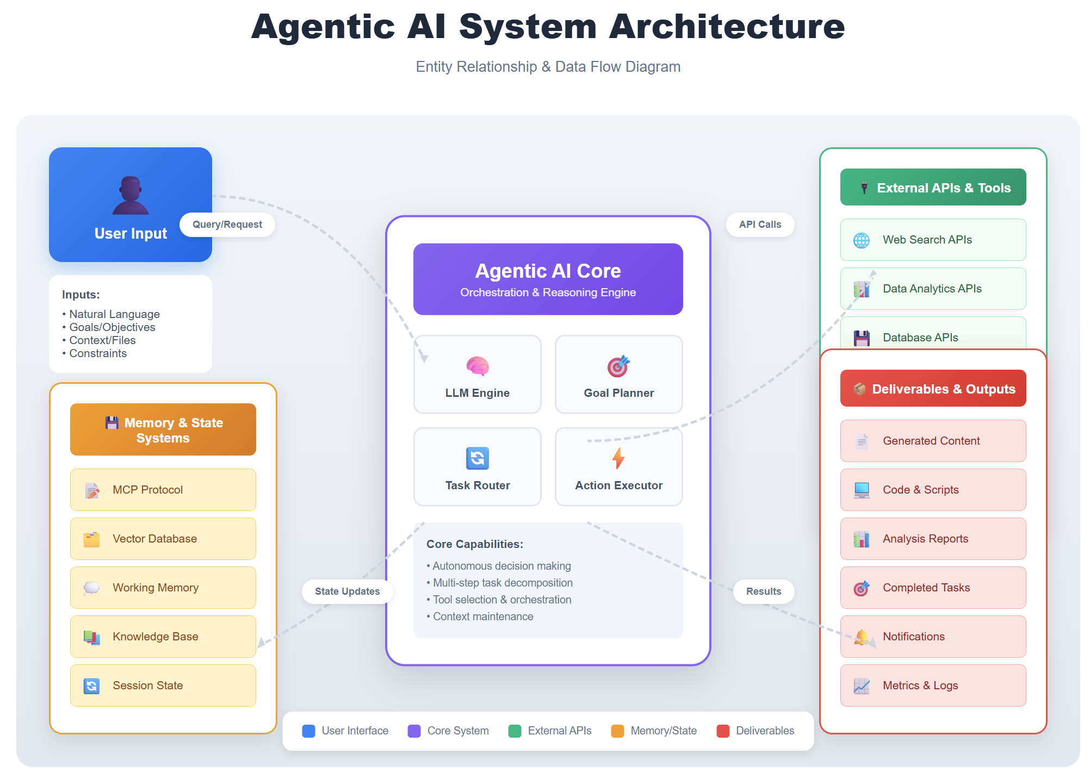

Slide 57
Multi-Agent Memory Sharing Architecture
🤖
Claude
💬
ChatGPT
Shared MCP
Memory Layer
👨‍💻
Copilot
🔧
Custom
Agent

Slide 58
Real-World Multi-Agent Scenario
📋 Scenario: Azure Course Development Pipeline
All agents share the same MCP memory of your course outline, student feedback, and code examples
🤖 Claude
💬 ChatGPT
👨‍💻 Copilot
Content Creation
Research & Analysis
Code Examples
• Write course modules
• Create exercises
• Generate assessments
• Review student work
• Web research
• Trend analysis
• Competitor review
• Market insights
• Write demo code
• Generate tests
• Debug issues
• Document APIs

Slide 59
📊 Production Monitoring
Observability and Performance Tracking
O'Reilly Learning Platform

Slide 60
Application Insights Dashboard
⏱️
🔄
❌
Response Time
Request Rate
Error Rate
< 500ms
1.2K/min
0.3%
Good
Normal
Low
💾
📊
👥
Memory Usage
Token Usage
Active Users
78%
45K/hr
324
OK
Efficient
Active

Slide 61
Thank you!
Course materials: timw.info/context
Contact: TechTrainerTim.com

